Slide 1
AI and Code: Two Projects from Next
Don Syme (dsyme@github.com) + all of GitHub Next
Principal Researcher, GitHub Next

Slide 2

GitHub Next
Researching the future of software development
githubnext.com

Slide 3
What is GitHub Next?
What
An applied R&D group attached to GitHub, reports to Thomas
Mission
Transform the practice of software development
Mode of Operation
Build, Release, Learn, Co-operate.
Who
~15 applied LLM/ML experts (many ex-Copilot), UX experts, CS experts
Why this is the right way to run innovative applied R&D
Operates at the Goldilocks distance!

Slide 4
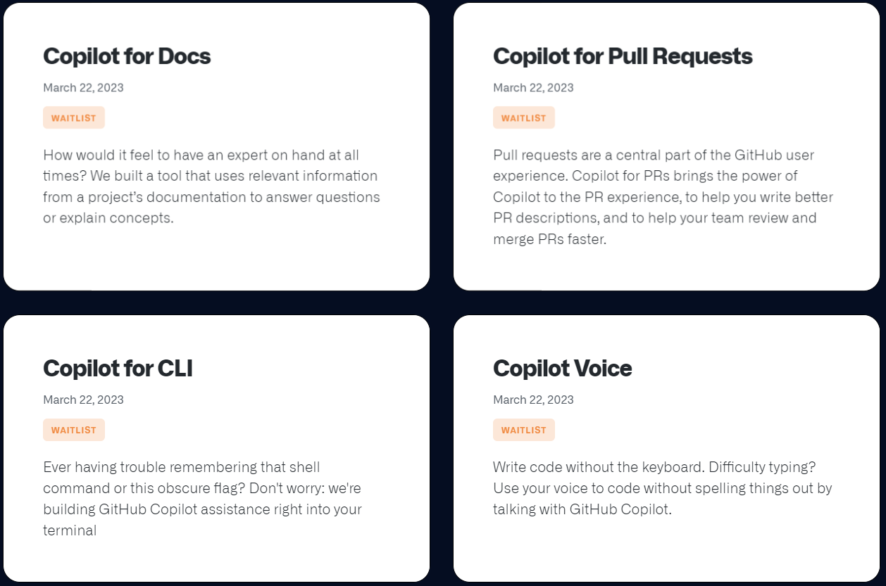
Released March 23!

Slide 5
Today’s Menu
Equipping GPT-4 with Numeric Calculation (clone)
Interlude
Pervasive Copilot summarization in GitHub
(aside: I help guide F# lang design ~10-50%)

Slide 6
Part 1 - Equipping GPT-4 with Numeric Calculation

Slide 7
caveat
AI is moving unbelievably fast. This work was done in ancient times, two weeks ago, before the ChatGPT “Code Interpreter” add-in was released
More on that in the interlude

Slide 8
Equipping for Numeric Calculation
The situation:
Any GPT-4 Chat: Context + Question ⇒ Answer

Slide 9
Equipping for Numeric Calculation
The situation:
Any GPT-4 Chat: Context + Question ⇒ Answer
The problem:
GPT-4 is utterly, disastrously, catastrophically terrible at numeric calculations
It’s also terrible at numeric comparisons
GPT-4 should not be trusted to write a number that is not present verbatim in the input, nor to reason about numbers in any significant way. In trust scenarios, don't allow GPT-4 to write numbers, and beware that every numeric comparison may be flawed.

Slide 10
How bad is this?
Very very bad

Slide 11
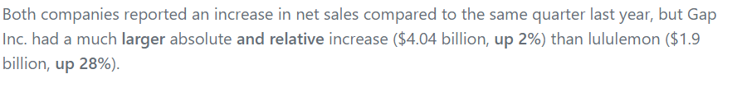

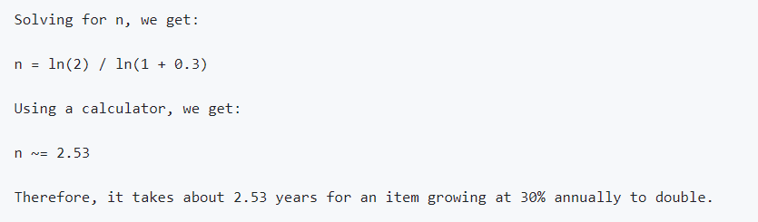
Example fails
Bing AI can’t be trusted
Example garbage:
More example garbage:

Slide 12
The Hope
The observation:
👎GPT-4 is terrible at numeric calculations
👍GPT-4 is good at writing numeric calculation code

Slide 13
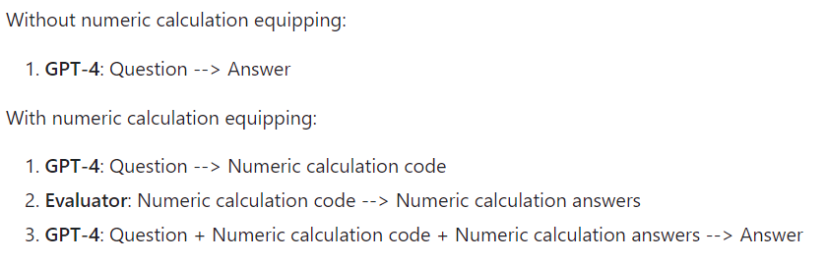
The Hope made Real
My opinion: this two-phase technique should be incorporated into every GPT-4 request that involves numbers unless explicitly known to be calculation-free. Anything else is

Slide 14
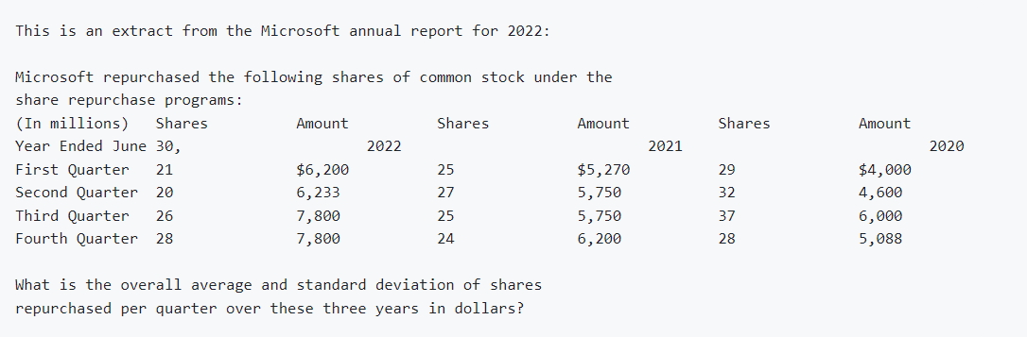
Example question

Slide 15
Example fail

Slide 16
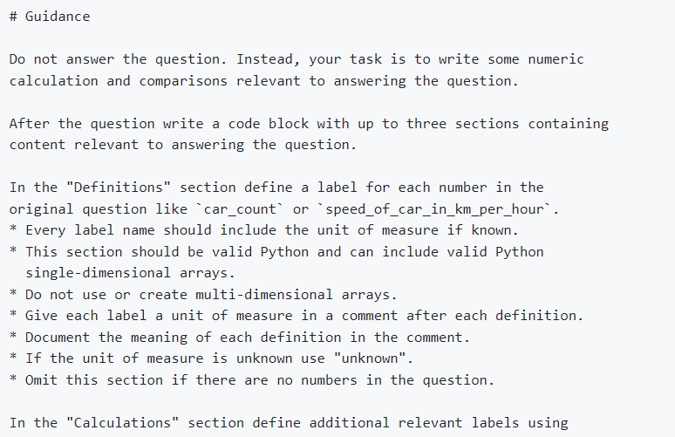
Example prompt

Slide 17
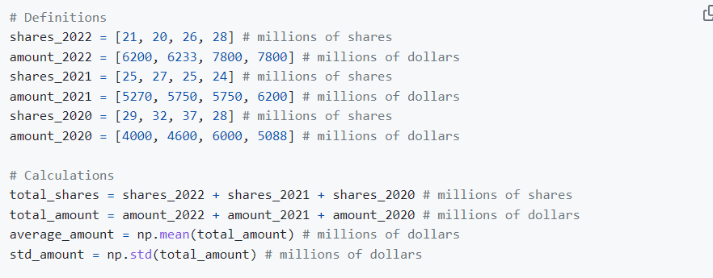
Example relevant calculation code

Slide 18
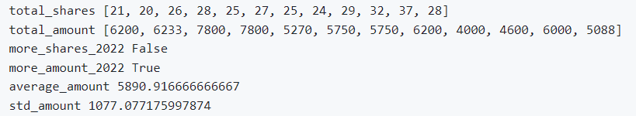
Example relevant results
Add code + results to the prompt, before the question

Slide 19
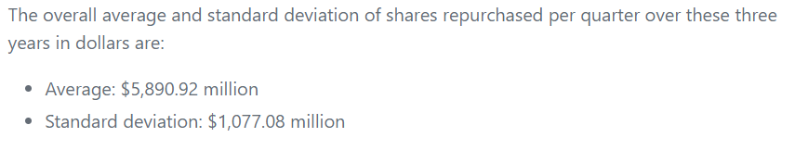
Example answer

Slide 20
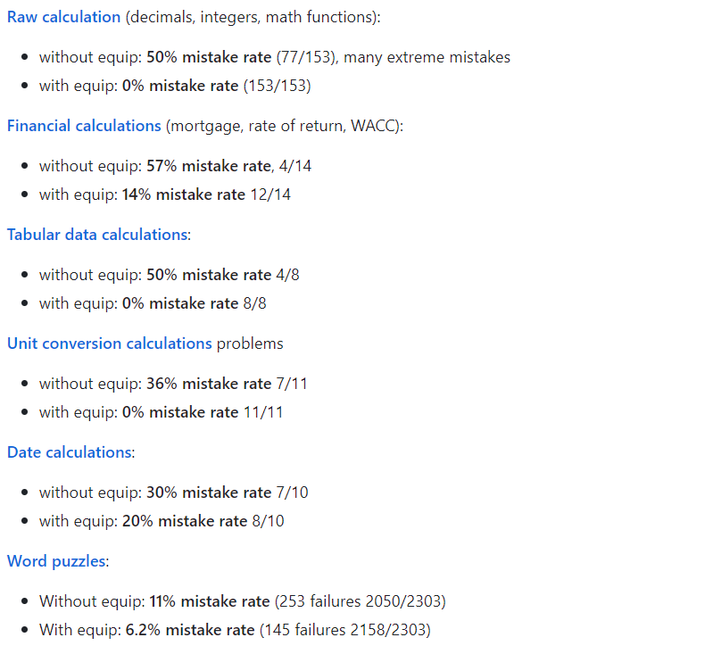
Effective?

Slide 21
On Explanation
The industry is crying out for AI that can be trusted, can be explained, can generate trustworthy, recognisable, analyzable artifacts like spreadsheets and notebooks.
Imagine this UX: hover over a number and you see the relevant calculation, and can get a spreadsheet or notebook for it.
By generating calculation code, we have a stepping stone to this.

Slide 22
Interlude - Welcome to the Future

Slide 23
Some mantras
Calculation is hard (for AI). Writing calculation code is easy.
Computation is hard (for AI). Writing code is easy.
(“Hey AI bro, you need that code after all?”)

Slide 24
Welcome to the Future
This category of technique can be applied to any language, computational logic, DSL, query language, library, service or computational capability.
The outputs can be answers, code, notebooks, spreadsheets, projects, tests, documentation.
The outputs can be generalized and deployed.

Slide 25
Welcome to the Future
Question ⇒ Answer

Slide 26
Welcome to the Future
Documentation + Description ⇒ Code
Code ⇒ Results
Documentation + Description + Results ⇒ Outputs
(AI can also iterate, plan, correct, generate tests)

Slide 27
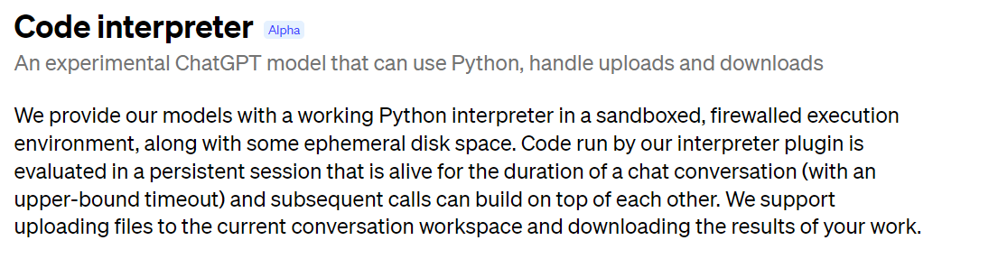
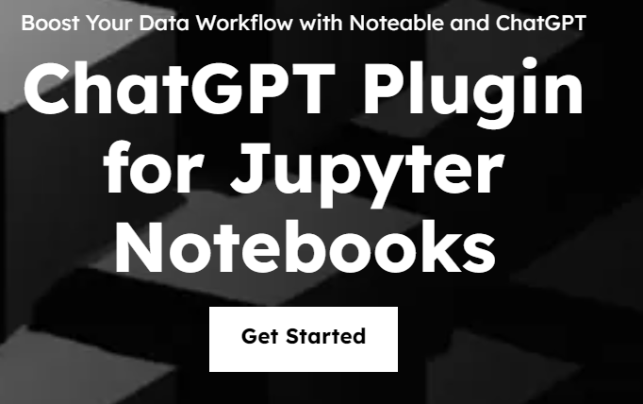
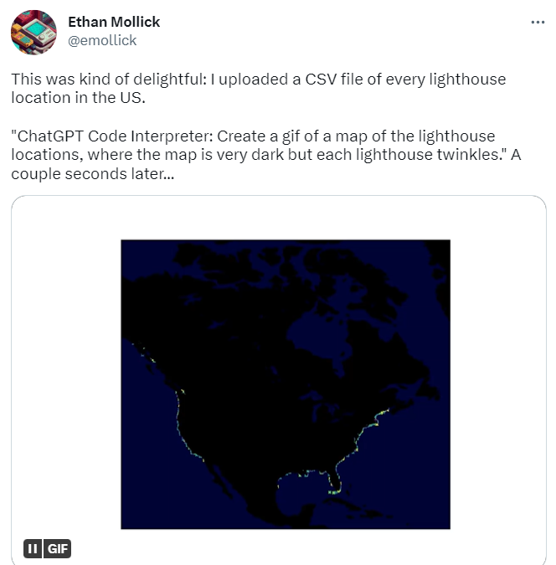
“Code Interpreter” ChatGPT AddIn

Slide 28
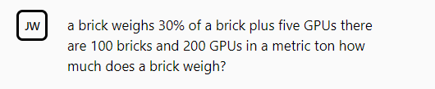
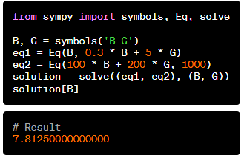
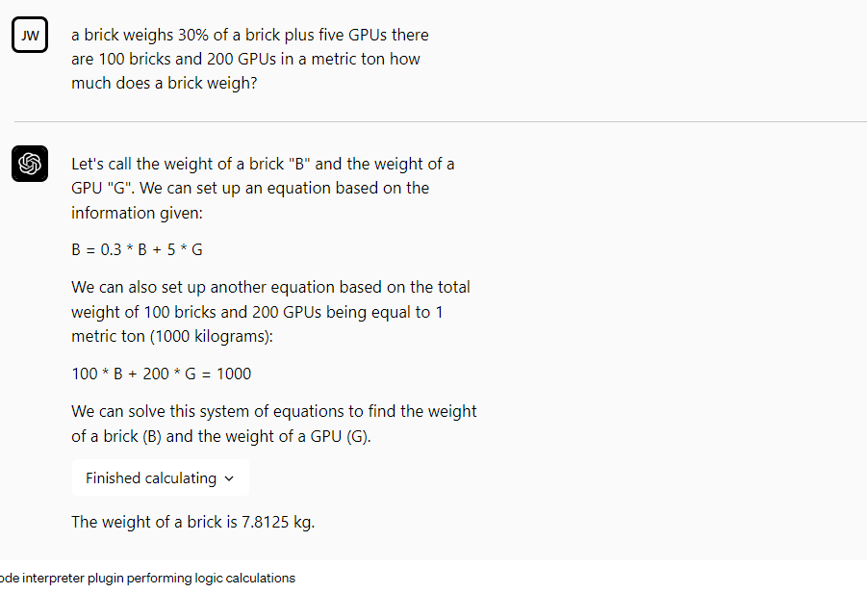

Slide 29
Welcome to the Future
The integration of Chat, Data and Programming is coming very fast. Much faster than I expected even a month ago.
We will now see an avalanche of ChatGPT addins. An app-like ecosystem will develop very rapidly, where addins have access to compute, storage, indexed documentation, networking, data resources, UX and more.
Important: chat is not just one thing:
Chat for Entertainment
Chat for Search
Chat for Analytical Question Answering
Chat for Technical Creation

Slide 30
Part 2 - Infusing github.com with AI Summaries
github.com/githubnext/prbot
githubnext.com/projects/copilot-for-pull-requests

Slide 31
Summarize all the things
Code ⇒ Summary (“Explain this code” in Copilot VS Code)
PR ⇒ Summary (Copilot for PRs)
File ⇒ Summary
Directory ⇒ Summary
Issue ⇒ Summary
Discussion ⇒ Summary
Repo => Summary
(multiple AI calls needed == hierarchical summarization)

Slide 32
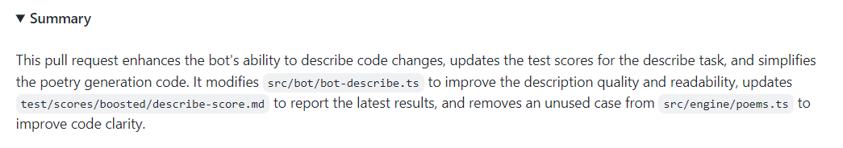
Example – PR Summary
./prbot describe https://github.com/githubnext/prbot/pull/565

Slide 33
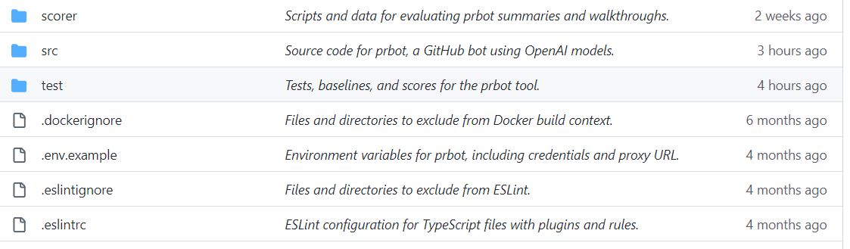
Sample short summaries for files

Slide 34
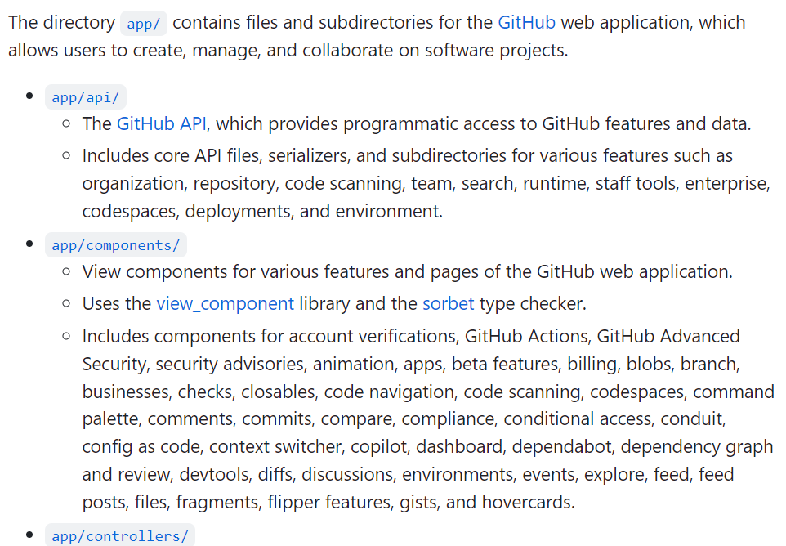
Hierarchical summaries of entire repositories
Overall summary of 1M+ LOC code in github/github “app” directory.
Every chunk, file, directory, issue, discussion gets a summary too.

Slide 35
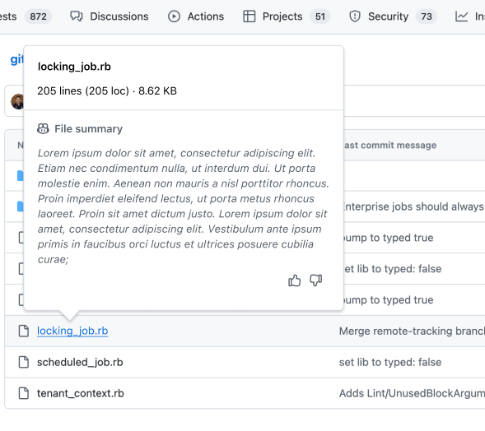
Some future UX (from github designers)

Slide 36
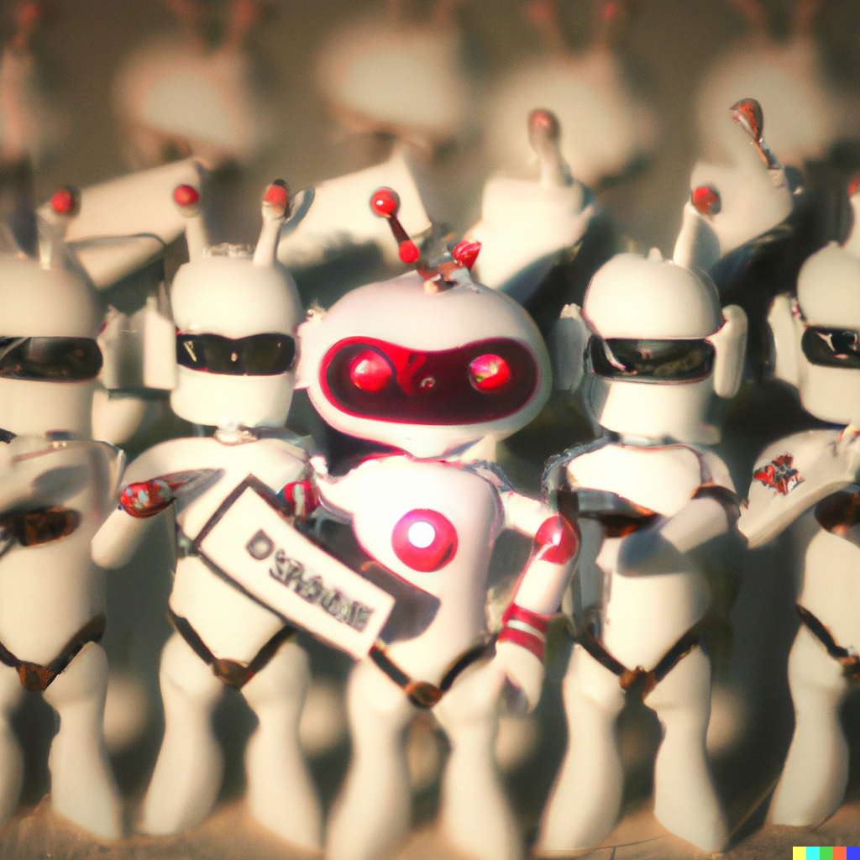
A bit of fun - AI Poetry for PRs
We unleash the prbot, the beast of AI
We measure its power, its skill and its price
We refine its language, its summaries and scores
We challenge the baseline, the human and the norms
Command line prbot-engine
Added for automation ease
Springtime coding bliss #!
No mercy for the bots, they cannot fool us
We log and return, we don't let them rule us
We parse the commands, we don't need the labels
We test the payloads, we are the rebels
Oh, we're the crew who code the bot, and we're the best you'll ever see
We review the changes in the files, with a fileIndex for each
We heave and ho and pull the rope, and make the locators neat
We're the crew who code the bot, and we're the pride of the fleet

Slide 37
A bit of fun - AI Stories for Repos
Based on overall summary of all 1M LOC code in github/github “app” directory
SAGAN: The `app/` directory is a microcosm of the human condition, a mirror of our strengths and weaknesses, our hopes and fears, our dreams and realities. It is a reminder of how far we have come, and how much further we can go....
MACHIAVELLI: To the magnificent and generous prince, who has graciously bestowed upon me the honor of examining the inner workings of his most esteemed and powerful enterprise, I dedicate this humble treatise on the directory `app/` in the repository `github/github`. ...the gateway to the prince's vast dominion of code and collaboration. ..
ATTENBOROUGH: In the vast and diverse ecosystem of GitHub, there is a hidden world of code that powers the web application millions of users rely on every day. This world is the app directory, where we can find files and subdirectories for various features and services that GitHub offers. Let's take a closer look at some of the inhabitants of this directory, and see how they interact and evolve.

Slide 38
Thank you!
dsyme@github.com

Slide 39
Context
The big game is using LLMs to bring assists to dev activities.
Many possible assists
Many different activities
Delivery in editor, monolith, application, command line and new modalities
LLMs are probabilistic text calculators
Text in, text out.
Key topics: prompts, context, control, quality, divide-and-conquer, chain-of-thought, hallucination.
LLMs are magical but difficult functions to integrate in high-trust scenarios.
Scepticism is healthy. Almost nothing in github.com today is probabilistic.
The human is almost certainly in-the-loop.

Slide 40
AI Outputs Overview
Summarization
Indexing
Chat
Generative
Critique

Slide 41
AI Outputs Overview
Summarization
Keywords
Title
Abstract
Walkthrough
Documentation
Indexing
Chat
Generative
Critique

Slide 42
Summarization: Rationale
We are headed to a world where most text associated with repos is emergent and automatic.
Content ⇒ Search Content ⇒ Text
Uses:
Abstracts, keywords, descriptions = for comprehension
Table of contents = for navigation
Documentation, walkthroughs = for explanation
Use cases:
Tool-tips Infopanel content
Seeding human-authored descriptions Search
Esp. when unfamiliar with content, pressed for time, or small-factor devices

Slide 43
Summarization: Technique
PR Chunks + some context
(GPT-4) → Descriptions of Chunks
(GPT-4) → Summaries of descriptions of chunks
(GPT-4) → Final outputs

Slide 44
Some Principles of AI UX
Utility
Quality
Trust
Handling Change

Slide 45
Some Principles of AI UX
Utility
The AI outputs must make some human task faster, or better
All new outputs take user attention. They aren’t free
Quality
Trust
Handling Change

Slide 46
Some Principles of AI UX
Utility
Quality
The AI makes mistakes, must be minimized
Small inputs + Longer outputs → More mistakes
The user must edit, approve/reject or tolerate
Users are more tolerant of mistakes in ephemeral outputs
Trust
Handling Change

Slide 47
Some Principles of AI UX
Utility
Quality
Trust
Mistakes are highly corrosive
Authorship must be understood
A human can explicitly take ownership after checking
Handling Change

Slide 48
Some Principles of AI UX
Utility
Quality
Trust
Handling Change
Outputs should be time-labelled, fresh and up-to-date
User-editing of outputs conflicts with freshness

Slide 49
Video of Copilot for PRs

